Slide 1

E-commerce Store
A new type of storefront.
This project will let us know the understanding of handling a large dataset, were we can filter the dataset by cleaning the dataset by using methods like removing null values,duplicate values from the dataset.
Exploratory Data Analysis (EDA)- Perform basic exploratory data analysis to understand the dataset.

Slide 2
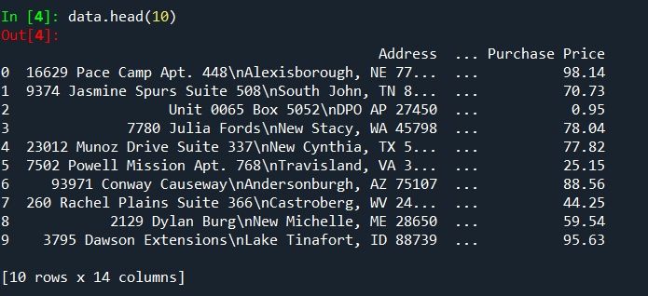
A new type of storefront.
1. Display Top 10 Rows of The Dataset
data.head(10)

Slide 3
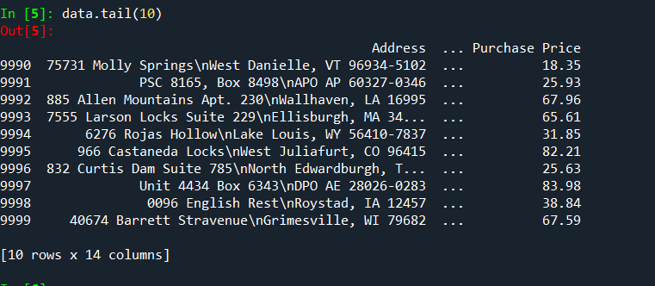
A new type of storefront.
#2. Check Last 10 Rows of The Dataset
data.tail(10)

Slide 4
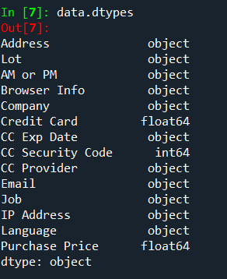
A new type of storefront.
#3. Check Datatype of Each Column
data.dtypes

Slide 5
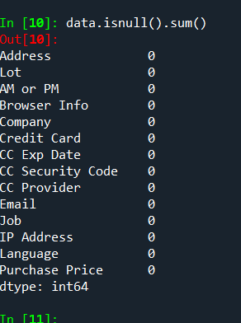
#4. Check null values in the dataset
A new type of storefront.
data.isnull().sum()

Slide 6
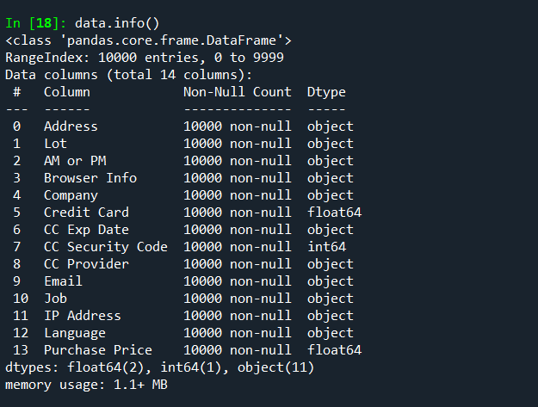
A new type of storefront.
#5. How many rows and columns are there in our Dataset?
data.info()

Slide 7


#6. Highest and Lowest Purchase Prices.
A new type of storefront.
data.columns - - 'see the name of the prize column first'
data['Purchase Price'].min()
data['Purchase Price'].max()

Slide 8

A new type of storefront.
#7.Average Purchase Price
data['Purchase Price'].mean()

Slide 9

A new type of storefront.
#8. How many people have French 'fr' as their Language?
data.columns - #see the column name and tyoe the correct column to get the out-put
len(data[data['Language']=='fr'])

Slide 10
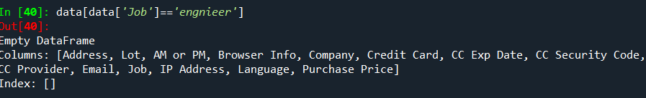
A new type of storefront.
9. Job Title Contains Engineer
data.columns
data[data['Job'].str.contains('enginerr',case=False)]
Or
data[data['Job']=='engnieer']

Slide 11
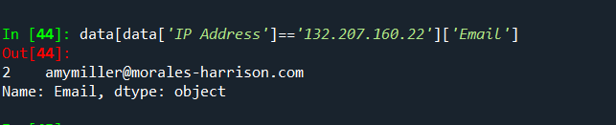
A new type of storefront.
10. Find The Email of the person with the following IP Address: 132.207.160.22
data.columns
data[data['IP Address']=='132.207.160.22']['Email']

Slide 12
A new type of storefront.
11. How many People have Mastercard as their Credit Card Provider and made a purchase above 50?
len(data[(data['CC Provider']=='Mastercard') & (data['Purchase Price']>50)])

Slide 13
A new type of storefront.
#12. Find the email of the person with the following Credit Card Number: 4664825258997302
data.columns
data[data['Credit Card']== 4664825258997302]['Email']

Slide 14
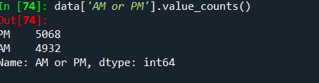
A new type of storefront.
#13. How many people purchase during the AM and how many people purchase during PM?
data.columns
data['AM or PM'].value_counts()

Slide 15
A new type of storefront.
#14. How many people have a credit card that expires in 2020?
data.columns
data['CC Exp Date']
len(data[data['CC Exp Date'].apply(lambda x:x[4:]=='20')])

Slide 16
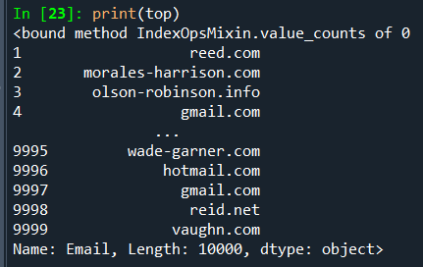
A new type of storefront.
#15. What are the top 5 most popular email providers (e.g. gmail.com, yahoo.com, etc...)
data.columns
data['Email']
top = data['Email'].apply(lambda x:x.split('@')[1]).value_counts

Slide 17
A new type of storefront.

